Slide 1
Searching and Sorting
Lecture # 5

Slide 2
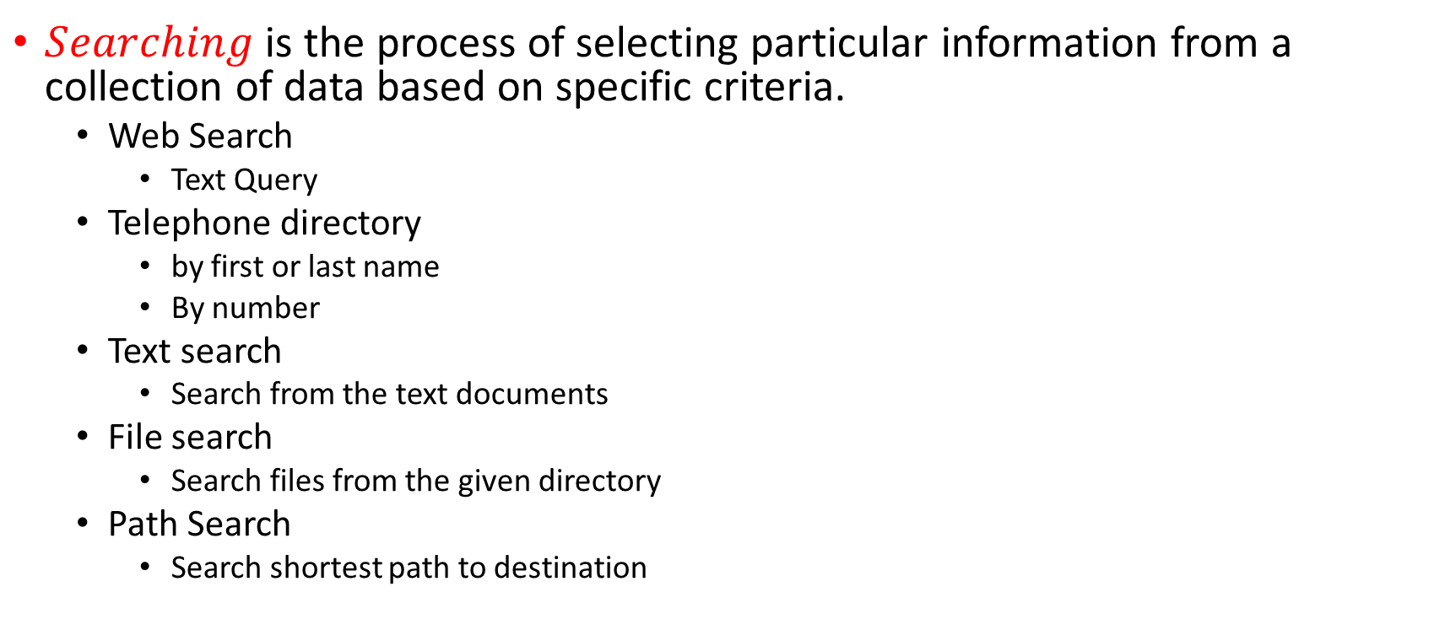
Searching
$Searching$ is the process of selecting particular information from a collection of data based on specific criteria.
Web Search
Text Query
Telephone directory
by first or last name
By number
Text search
Search from the text documents
File search
Search files from the given directory
Path Search
Search shortest path to destination

Slide 3
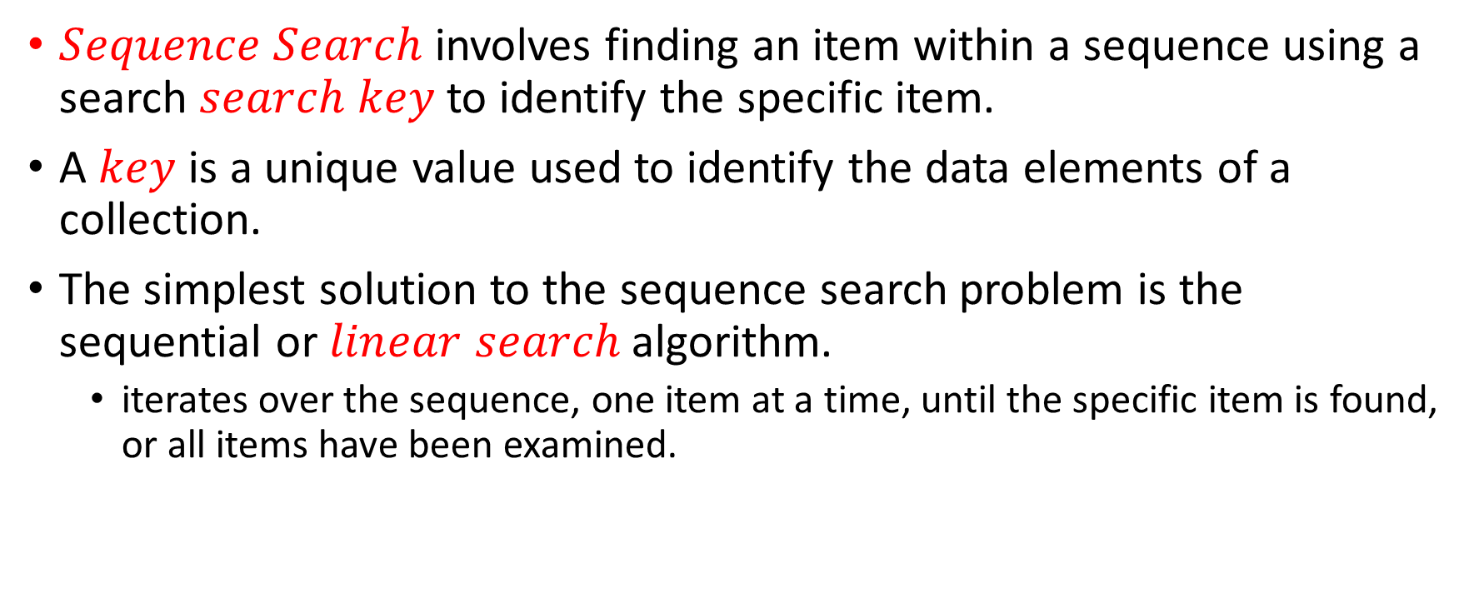
Sequence Searching
$Sequence Search$ involves finding an item within a sequence using a search $search key$to identify the specific item.
A $key$ is a unique value used to identify the data elements of a collection.
The simplest solution to the sequence search problem is the sequential or $linear search$ algorithm.
iterates over the sequence, one item at a time, until the specific item is found, or all items have been examined.
if key in theArray : print( "The key is in the array." ) else : print( "The key is not in the array." )

Slide 4
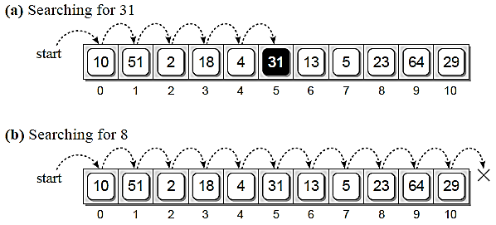

Sequence Searching
The use of the $in$ operator makes our code simple and easy to read but it hides the inner workings.
Underneath, the $in$ operator is implemented as a $linear search$.

Slide 5
Linear/Sequential Search
Sequential search algorithm, which results in a Boolean value indicating success or failure of the search.
A count-controlled loop is used to traverse through the sequence during which each element is compared against the target value.
If the item is in the sequence, the loop is terminated and True is returned. Otherwise, a full traversal is performed and False is returned after the loop terminates.

Slide 6
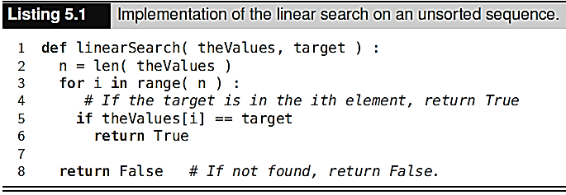
Linear/Sequential Search

Slide 7
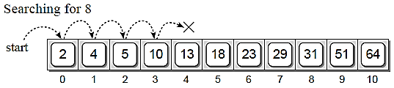
Searching a Sorted Sequence
A linear search on a sorted sequence works in the same fashion as that for the unsorted sequence, with one exception.
It's possible to terminate the search early when the value is not in the sequence instead of always having to perform a complete traversal.
The only modification to the earlier version is the inclusion of a test to determine if the current item within the sequence is larger than the target value.

Slide 8
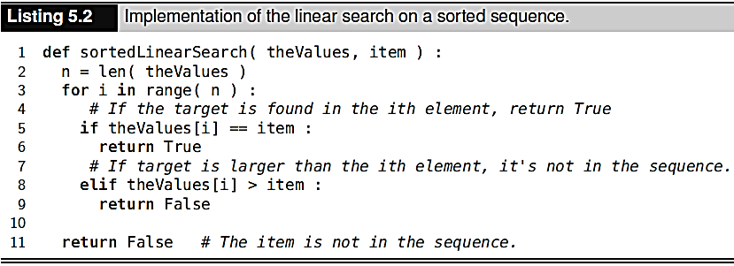
Searching a Sorted Sequence

Slide 9
The Binary Search
The linear search algorithm for a sorted sequence produced a slight improvement over the linear search with an unsorted sequence, but both have a linear time-complexity in the worst case.
The binary search algorithm starts by examining the middle item of the sorted sequence, resulting in one of three possible conditions:
the middle item is the target value,
the target value is less than the middle item,
or the target is larger than the middle item.
Since the sequence is ordered, we can eliminate half the values in the list when the target value is not found at the middle position.

Slide 10
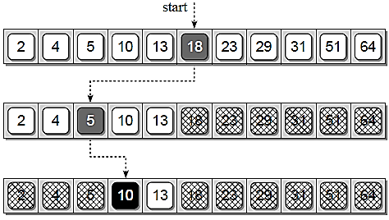
The Binary Search
Search value 10 from the following sorted array.

Slide 11
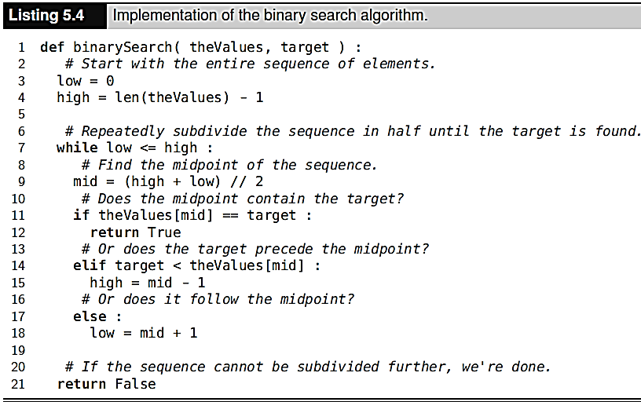
The Binary Search - Implementation

Slide 12
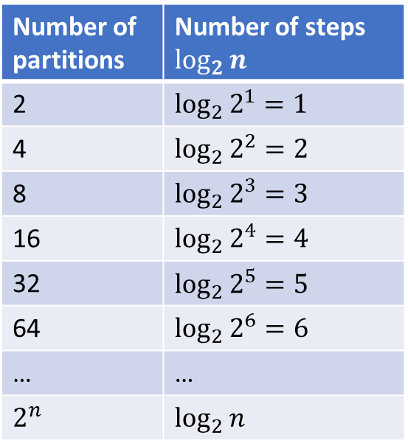

The Binary Search – Run Time Analysis
Division is performed in $\log_{2}{n}$ manner,
Number of partitions | Number of steps $\log_{2}{n}$
2 | $$\log_{2}{2^{1}=1}$$
4 | $$\log_{2}{2^{2}}=2$$
8 | $$\log_{2}{2^{3}=3}$$
16 | $$\log_{2}{2^{4}=4}$$
32 | $$\log_{2}{2^{5}=5}$$
64 | $$\log_{2}{2^{6}=6}$$
… | …
$$2^{n}$$ | $$\log_{2}{n}$$

Slide 13
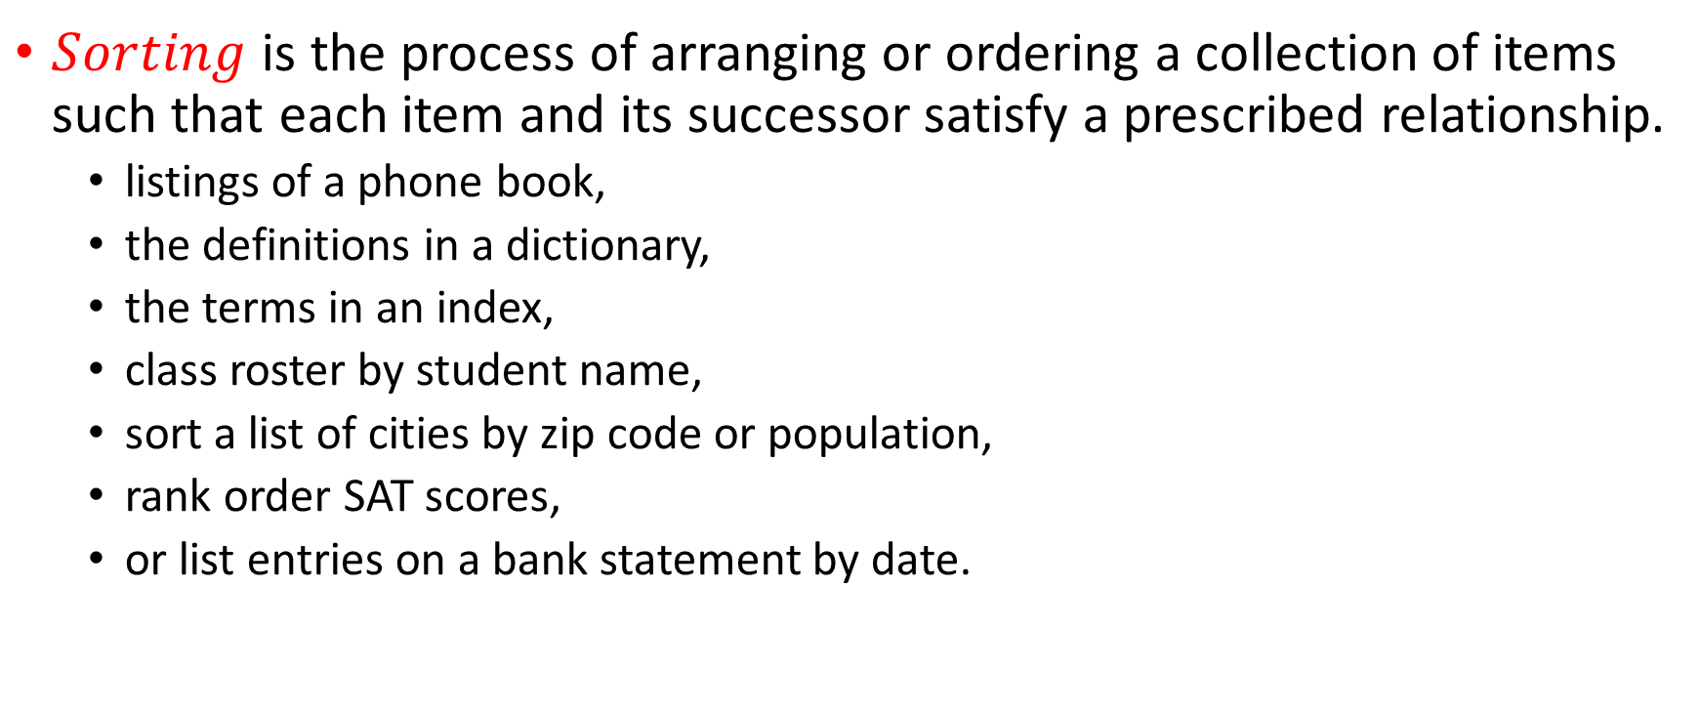
Sorting
$Sorting$ is the process of arranging or ordering a collection of items such that each item and its successor satisfy a prescribed relationship.
listings of a phone book,
the definitions in a dictionary,
the terms in an index,
class roster by student name,
sort a list of cities by zip code or population,
rank order SAT scores,
or list entries on a bank statement by date.

Slide 14
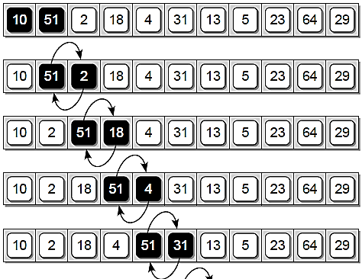
Bubble Sort
A simple solution to the sorting problem is the bubble sort algorithm, which re-arranges the values by iterating over the list multiple times, causing larger values to bubble to the top or end of the list.

Slide 15
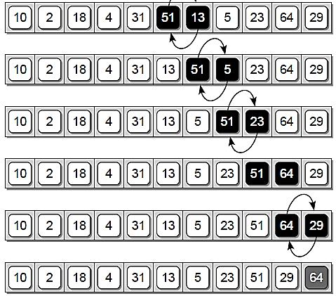
Bubble Sort
A simple solution to the sorting problem is the bubble sort algorithm, which re-arranges the values by iterating over the list multiple times, causing larger values to bubble to the top or end of the list.

Slide 16
Bubble Sort - Implementation
# Sorts a sequence in ascending order using the bubble sort algorithm. def bubbleSort(theSeq): n = len(theSeq) # Perform n-1 bubble operations on the sequence for i in range(n - 1): # Bubble the largest item to the end. for j in range(n - 1-i): if theSeq[j] > theSeq[j + 1]: # swap the j and j+1 items. tmp = theSeq[j] theSeq[j] = theSeq[j + 1] theSeq[j + 1] = tmp return theSeq

Slide 17
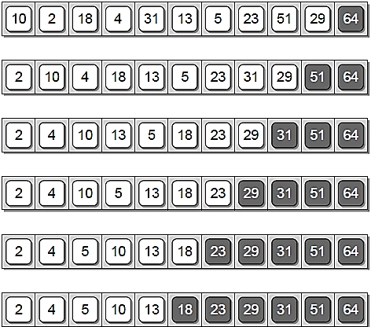
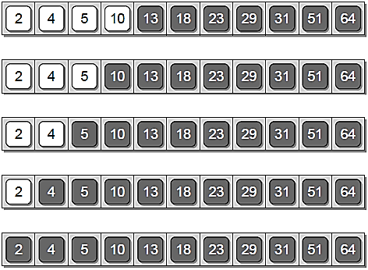
Bubble Sort - Implementation

Slide 18

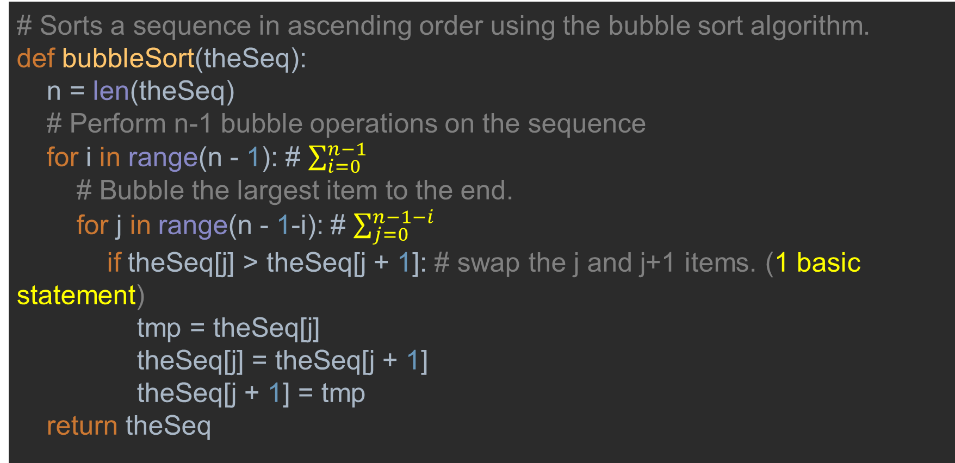
Bubble Sort - Implementation
# Sorts a sequence in ascending order using the bubble sort algorithm. def bubbleSort(theSeq): n = len(theSeq) # Perform n-1 bubble operations on the sequence for i in range(n - 1): # $\sum_{i=0}^{n−1}{}$ # Bubble the largest item to the end. for j in range(n - 1-i): # $\sum_{j=0}^{n−1−i}{}$ if theSeq[j] > theSeq[j + 1]: # swap the j and j+1 items. (1 basic statement) tmp = theSeq[j] theSeq[j] = theSeq[j + 1] theSeq[j + 1] = tmp return theSeq
$$C\left(n\right)=\sum_{i=0}^{n−1}{\sum_{j=0}^{n−1−i}{1}=\sum_{i=0}^{n−1}{n−i}=\frac{n(n+1)}{2}}$$
$$C\left(n\right)∈(n^{2})$$

Slide 19
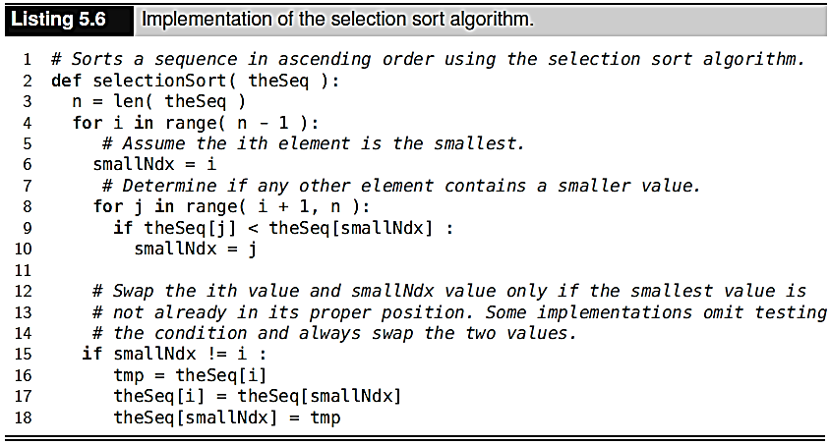

Selection Sort
$Selection Sort$ works in a fashion similar to what a human may use to sort a list of values.
[7, 6, 5, 4, 3, 2, 1]
[1, 6, 5, 4, 3, 2, 7]
[1, 2, 5, 4, 3, 6, 7]
[1, 2, 3, 4, 5, 6, 7]
[1, 2, 3, 4, 5, 6, 7]

Slide 20
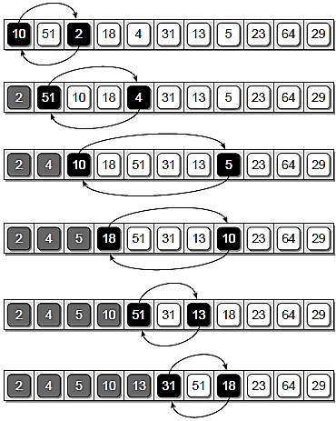
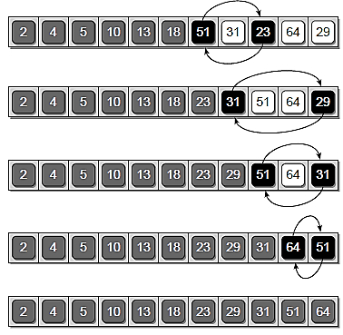
Selection Sort

Slide 21
Selection Sort
[7, 6, 5, 4, 3, 2, 1]
[1, 6, 5, 4, 3, 2, 7]
[1, 2, 5, 4, 3, 6, 7]
[1, 2, 3, 4, 5, 6, 7]
[1, 2, 3, 4, 5, 6, 7]
def selectionSort(theSeq): n = len(theSeq) for i in range(n-1): print(theSeq) smallNdx = i for j in range(i+1, n):#check if any element aftrer i contains smaller value if theSeq[j] < theSeq[smallNdx]: smallNdx = j if smallNdx != i: tmp = theSeq[i] theSeq[i] = theSeq[smallNdx] theSeq[smallNdx] = tmp return theSeq

Slide 22
Insertion Sort
In the insertion sort algorithm, we assume that a certain portion of the list has already been sorted, while the other portion remains unsorted.
With this assumption, we move through the unsorted portion of the list, picking one element at a time.
With this element, we go through the sorted portion of the list and insert it in the right order so that the sorted portion of the list remains sorted.

Slide 23
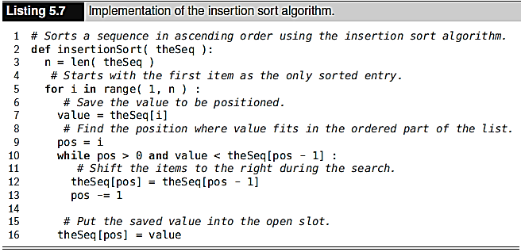
Insertion Sort
[10, 51, 2, 18, 4, 31, 13, 5, 23, 64, 29]
[10, 51, 2, 18, 4, 31, 13, 5, 23, 64, 29]
[10, 51, 51, 18, 4, 31, 13, 5, 23, 64, 29]
[10, 10, 51, 18, 4, 31, 13, 5, 23, 64, 29]
[2, 10, 51, 18, 4, 31, 13, 5, 23, 64, 29]
[2, 10, 51, 51, 4, 31, 13, 5, 23, 64, 29]
[2, 10, 18, 51, 4, 31, 13, 5, 23, 64, 29]
[2, 10, 18, 51, 51, 31, 13, 5, 23, 64, 29]
[2, 10, 18, 18, 51, 31, 13, 5, 23, 64, 29]
[2, 10, 10, 18, 51, 31, 13, 5, 23, 64, 29]
[2, 4, 10, 18, 51, 31, 13, 5, 23, 64, 29]
[2, 4, 10, 18, 51, 51, 13, 5, 23, 64, 29]
[2, 4, 10, 18, 31, 51, 13, 5, 23, 64, 29]
[2, 4, 10, 18, 31, 51, 51, 5, 23, 64, 29]
[2, 4, 10, 18, 31, 31, 51, 5, 23, 64, 29]
[2, 4, 10, 18, 18, 31, 51, 5, 23, 64, 29]
[2, 4, 10, 13, 18, 31, 51, 5, 23, 64, 29]
[2, 4, 10, 13, 18, 31, 51, 51, 23, 64, 29]
[2, 4, 10, 13, 18, 31, 31, 51, 23, 64, 29]
[2, 4, 10, 13, 18, 18, 31, 51, 23, 64, 29]
[2, 4, 10, 13, 13, 18, 31, 51, 23, 64, 29]
[2, 4, 10, 10, 13, 18, 31, 51, 23, 64, 29]
[2, 4, 5, 10, 13, 18, 31, 51, 23, 64, 29]
[2, 4, 5, 10, 13, 18, 31, 51, 51, 64, 29]
[2, 4, 5, 10, 13, 18, 31, 31, 51, 64, 29]
[2, 4, 5, 10, 13, 18, 23, 31, 51, 64, 29]
[2, 4, 5, 10, 13, 18, 23, 31, 51, 64, 29]
[2, 4, 5, 10, 13, 18, 23, 31, 51, 64, 64]
[2, 4, 5, 10, 13, 18, 23, 31, 51, 51, 64]
[2, 4, 5, 10, 13, 18, 23, 31, 31, 51, 64]

Slide 24
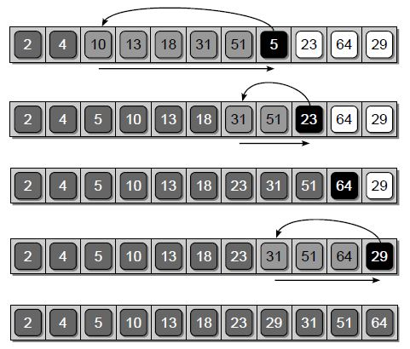
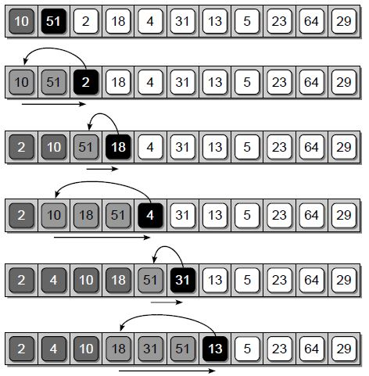
Insertion Sort

Slide 25
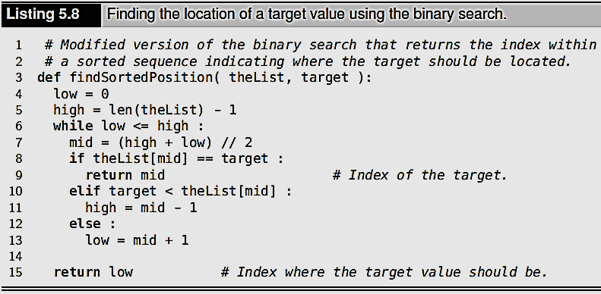
Maintaining a Sorted List

Slide 26
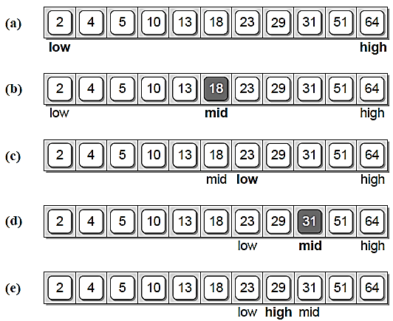
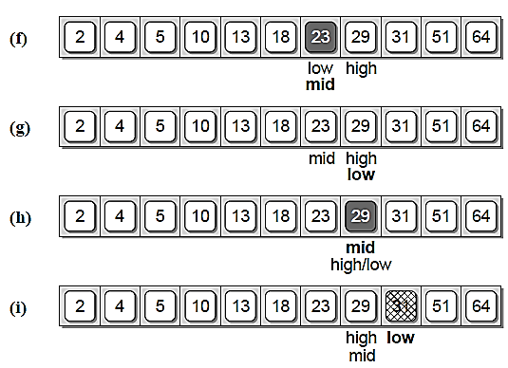
Maintaining a Sorted List
Performing a binary search on a sorted list when searching for value 25.

Slide 27
Merging Sorted Lists
Sometimes it may be necessary to take two sorted lists and merge them to create a new sorted list.
>>> listA = [ 2, 8, 15, 23, 37 ]
>>> listB = [ 4, 6, 15, 20 ]
>>> newList = mergeSortedLists( listA, listB )
>>> print( newList )
[2, 4, 6, 8, 15, 15, 20, 23, 37]

Slide 28
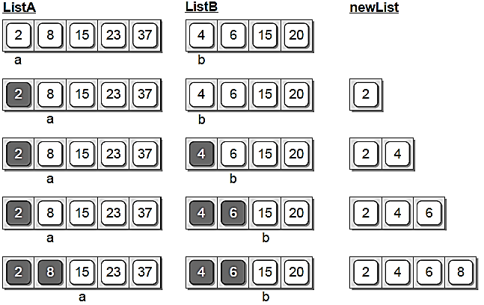
Merging Sorted Lists

Slide 29
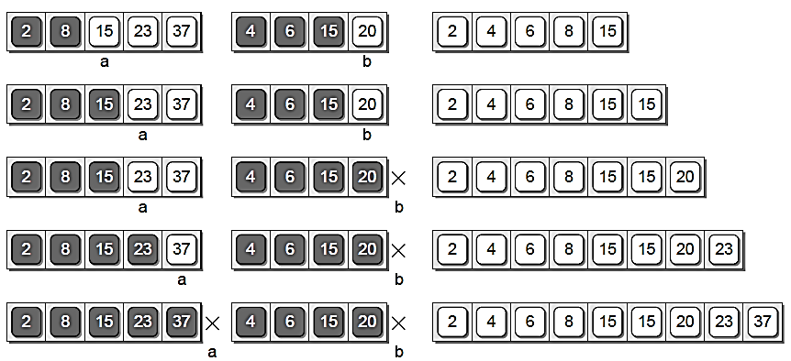
Merging Sorted Lists

Slide 30
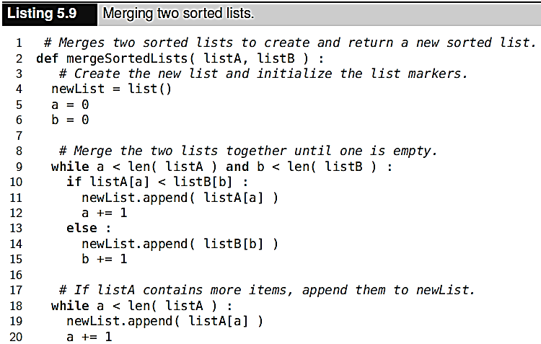
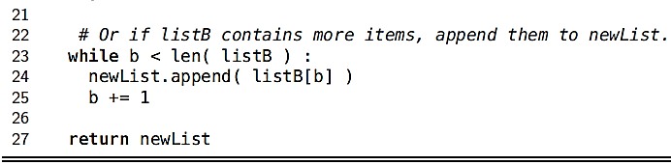
Merging Sorted Lists

Slide 31
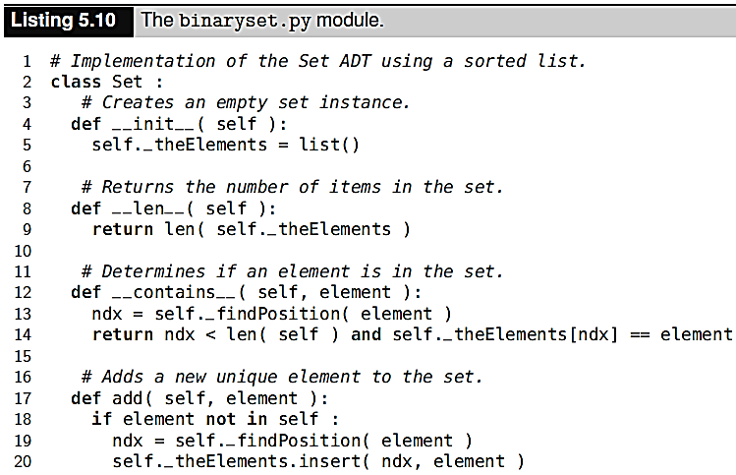
Sorted Set ADT

Slide 32
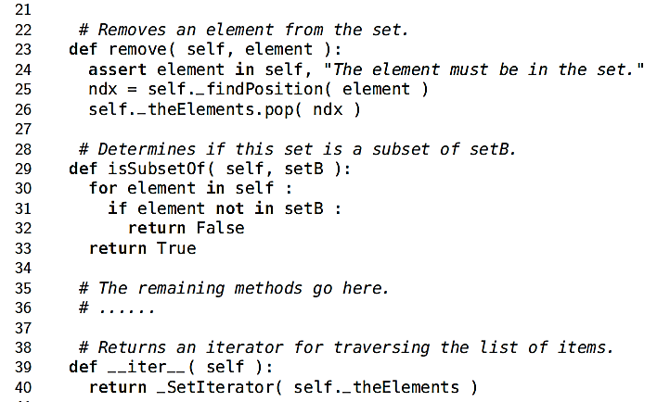
Sorted Set ADT

Slide 33
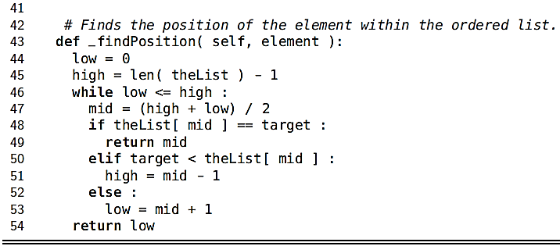
Sorted Set ADT

Slide 34
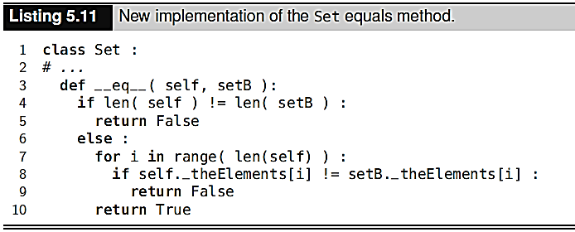
Sorted Set ADT

Slide 35
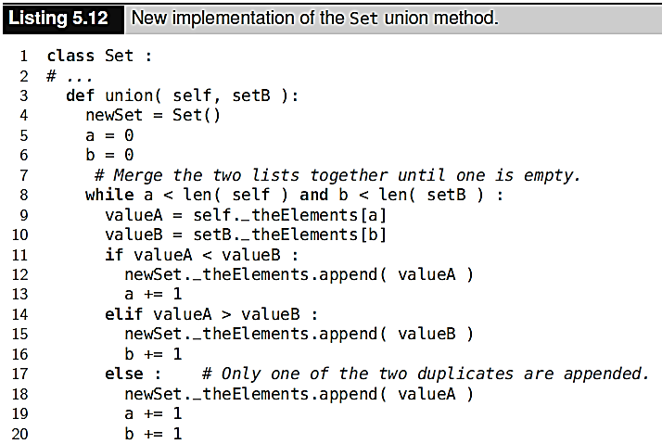
Sorted Set ADT

Slide 36
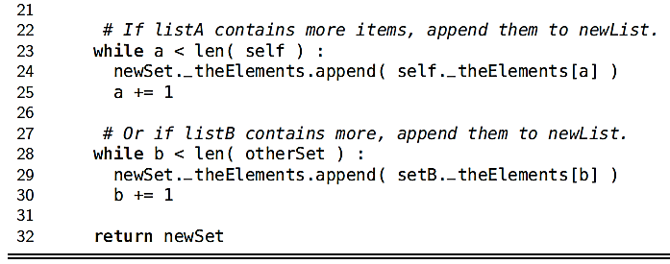
Sorted Set ADT

